Slide 1

SKILLS NEEDS ANTICIPATION :
Czech experience
Věra Czesaná
National Training Fund
National Observatory of Employment and Training
Validation Seminar on Methodological Guides for Skills Anticipation and Matching
Cedefop-ILO-ETF expert seminar
Prague, 6-7 March 2014

Slide 2
STRUCTURE OF THE PRESENTATION
What we are (NTF + NOET)
What we do
NOET activities in the field of anticipation
Anticipation system in the Czech Republic

Slide 3
National Training fund
Independent not-for-profit NGO operating since 1994
Provides services in the area of
  labour market analyses and policy analyses
  research in the area of human resources quality
  promotion of human resources development strategies
  development of guidance services in employment and education sectors
  training for social services providers of in the field of quality standards
  audits of social services quality
  administration of projects and project management

Slide 4
National Observatory of Employment and Training
Analytic and research unit of the National Training Fund
NOET team – 11 experts (expert background in economy or sociology, age, gender, skills and expertise balanced – systematically built
Most services produced in-house
Project based funding – 40% grants, 60% contracts
Clients - mainly Czech public authorities,
- European authorities: Cedefop, European Commission,
- Foreign public organisations (Lithuania – Public Policy and Management Institute; Poland - Labour Market and Education Observatory of Małopolska),
- domestic public and private organisations

Slide 5
NOET MAIN ACTIVITIES
  Analysis and monitoring in the field of labour market and education
  Anticipation activities:
    Quantitative skill needs forecasting at the national level
    Sector studies
    Short term labour market prediction tools
    EU level forecasting involvement
    New labour market information products

Slide 6

Analyses
Periodical activities
Competitiveness yearbook – Quality of human resources in the Czech Republic
(Statistics and analyses)
Ad-hoc analytical projects
YOUTH (EC project)
Transferable skills (EC project)
PIAAC analysis (OECD project)
Analysis of HR in the R+D+I system (Office of the Czech Government)
Analytical surveys for different customers
Inequalities in participation in CVET (MoEYS)
Monitoring of CVET (MoEYS)
….

Slide 7
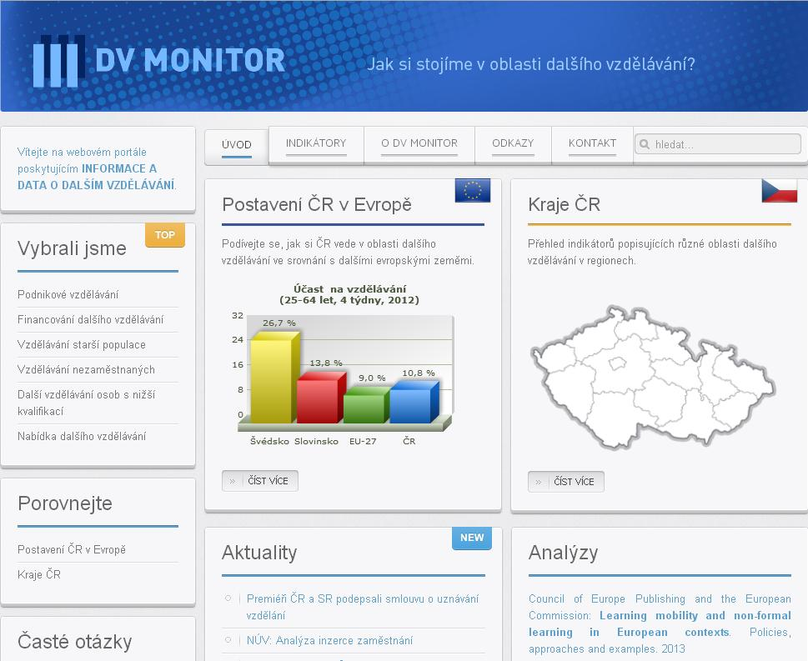
Monitoring
System for continuing education and training monitoring
Data collection, analysis, presentation and product delivery to end users
Based on indicators of CET
Available to public at DVmonitor.cz website

Slide 8
Products
  We are aiming at:
  Customisation - tailor-made solutions for different clients
  User-friendly formats
  Online availability and interactivity (some products)
  Product types:
  Publications and printed materials
  Reports and studies (printed or electronic)
  Customised LMI products (at glance, in-depth, profiles)
  Websites
  Consulting
  Conferences and workshops

Slide 9
NOET MAIN ACTIVITIES
  Analysis and monitoring in the field of labour market and education
  Anticipation activities:
    Quantitative skill needs forecasting at the national level
    Sector studies
    Short term labour market prediction tools
    EU level forecasting involvement
    New labour market information products

Slide 10
Quantitative forecasting
  Model ROA-CERGE
  Developed in ROA (Netherlands) – since 2001 being implemented in CR
  Since than methodological improvements
  Time horizon: 5 years
  Results:
    Indicators of future labour market prospects for 27 educational groups
    Extension and replacement demand for 27 educational groups and 30 occupational groups
    New methodological elements: substitution demand; shift-share analysis; index of wage attractivity

Slide 11
MODEL ROA-CERGE
Macroeconomic projection
Projection of employment by industry (15 of 42 sectors)
Structure of employment and unemployment by age, education, industry and occupation
Projection of graduates
MEYS
NOET + MF
LFS – Czech Statistical Office
Labour market prospects for occupational and educational groups
Ministry of Finance
NOET+CERGE+RILSA

Slide 12
LIMITATIONS AND challenges
ADVANTAGES
Decomposition of labour demand into replacement and expansion components
Includes projected demographic trends, economic activity rates
Shows the outflow and inflow of workers for specific occupations
LIMITATIONS
Importance of data quality and robustness + sometimes brakes in time series (recalculations are needed)
Sample size limits the detail of results (breakdown by occupations, regions)
Can not reflect the current new emerging jobs and changes of skills in specific occupations
CHALLENGES
Adjustments in occupational clusters
Development of sectoral macroeconomic model (employment)
Quantitative forecasting at the regional level
Better information on foreign labour force – model improvements
Notes:
12

Slide 13
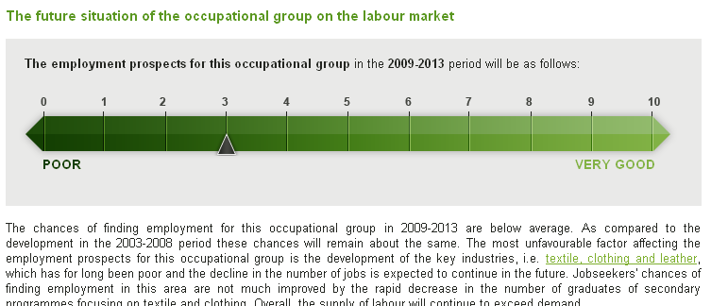
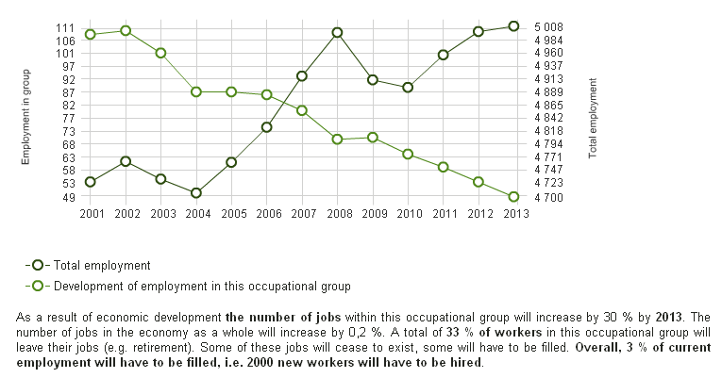
results
Notes:
13

Slide 14
Results
Notes:
14

Slide 15
NOET MAIN ACTIVITIES
  Analysis and monitoring in the field of labour market and education
  Anticipation activities:
    Quantitative skill needs forecasting at the national level
    Sector studies
    Short term labour market prediction tools
    EU level forecasting involvement
    New labour market information products

Slide 16
SECTOR STUDIES
The objective is to provide 5-15 year outlook on possible development in selected sector, including threats and opportunities regarding labour market and skill needs
Base for strategies and policies on national, sectoral and regional level
TOOLS INCLUDE:
In-depth interviews
Surveys (employers, education providers, researchers)
Data mining and analyses
Scenario thinking
Strategic sectoral balance

Slide 17
Steps of a sector study
SECTOR SELECTION:
Based on an analysis of both potentials and threats for the entire Czech economy – we choose promising or declining sectors
(in house) ANALYSIS OF SECTOR PROSPECTS: Strategic balance of factors, influencing sector (not SWOT, it is more sophisticated):
(in house) DEMAND/SUPPLY SIDE ANALYSIS:
ROA-Cerge model outputs, projection of school leavers etc.
(outsourced) QUALITATIVE RESEARCH: Focus Groups, Interviews
(in-house) SYNTHESIS:
Sector scenarios, recommendations, regional specifics

Slide 18

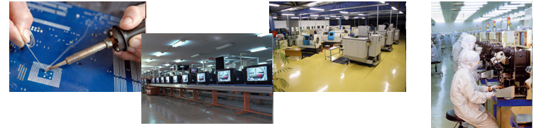

Qualitative forecasting
- SECTOR STUDIES
POWER SUPPLY INDUSTRY
  Outputs of 3 sector studies with 2020 outlook and detailed analysis of employment and trends:
ELECTRONICS/ELECTROENGINEERING
ICT SERVICES

Slide 19
SECTOR STUDIES
Advantages
  In-depth look down to the skills level
  Reveal emerging jobs and skills
    Transversal competencies
    Combination of technical and soft skills (e.g. business skills)
Limits
    Difficult assessment of the scope of new jobs and skills
    Too optimistic view of stakeholders
    Difficulties in cross-sector comparisons
    Hard to combine with external data
    Time and resource demanding
Sectoral profiles – simpler study based on secondary analysis, data trends, key professions and education fields

Slide 20
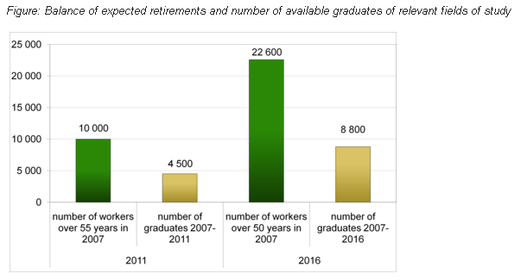
results
Mechanical engineering – upper secondary education level – fields of mechanics, metalwork's

Slide 21
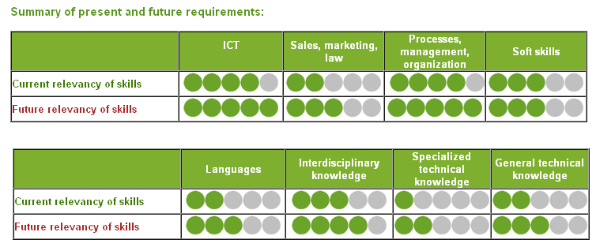
results
IS/IT manager

Slide 22
NOET MAIN ACTIVITIES
  Analysis and monitoring in the field of labour market and education
  Anticipation activities:
    Quantitative skill needs forecasting at the national level
    Sector studies
    Short term labour market prediction tools
    EU level forecasting involvement
    New labour market information products

Slide 23
Short term Prediction
  Monitoring of vacancies
  Building a comprehensive database of job vacancies from available sources
  Unique methodology
  Piloted on sample of 33.000 job advertisements

Slide 24
341 Finance and sales associate professionals
512 Housekeeping and restaurant services workers
342 Business services agents and trade brokers
123 Other specialist managers
241 Business professionals
931 Mining and construction labourers
712 Building frame and related trades workers
311 Physical and engineering science technicians
213 Computing professionals (Computer systems designers, analysts and programmers)
343 Administrative associate professionals
214 Architects, engineers and related professionals
832 Motor vehicle drivers
521 Shop and market salespersons
913 Cleaners
222 Doctors
312 Computer associate professionals
932 Manufacturing labourers (in production)
828 Assemblers
722 Blacksmiths, tool-makers and related trades workers
422 Client information clerks
122 Production and operations managers
721 Metal moulders, welders, sheet-metal workers, structural-metal preparers, and related trades workers
713 Building finishers and related trades workers
131 Managers of small enterprises
724 Electrical and electronic equipment mechanics and fitters
TOP 25

Slide 25
Short term Prediction
  Forecasting model for unemployment
    Predicts cyclical changes in the rate unemployment (6 months)
    High precision prediction for the rate of unemployment (2 months)
    Based on labour office data

Slide 26
Short term Prediction Tools
  Advantages
  Can be easily automated
  Can be customised and built in internal IS of public institutions (PES, MLSA) to support decision making
  Can be used for further analysis
  Limits
  Data quality dependent (vacancies)
  Must be delivered quickly otherwise the results are useless
  Some results need to be produced in time series

Slide 27
NOET MAIN ACTIVITIES
  Analysis and monitoring in the field of labour market and education
  Anticipation activities:
    Quantitative skill needs forecasting at the national level
    Sector studies
    Short term labour market prediction tools
    EU level forecasting involvement
    New labour market information products

Slide 28

Involvement in European
forecasting activities
Forecasting skill supply and demand in Europe (Cedefop) – NOET as country experts
Developing and piloting an employer survey on skill needs in Europe (Cedefop) – extended group
Transferable skills across economic sectors (DG Employment)
ForJobs (Progress programme)

Slide 29
NOET MAIN ACTIVITIES
  Analysis and monitoring in the field of labour market and education
  Anticipation activities:
    Quantitative skill needs forecasting at the national level
    Sector studies
    Short term labour market prediction tools
    EU level forecasting involvement
    New labour market information products

Slide 30
PRODUCT examples
Qualification cards - about 180 professions – ISCO level 2 – 9 (4 digit structure)
Identification of professions that:
are important at the labour market and where jobs are growing
have potential for future expansion
are placed in sectors with a good outlook
are attractive as concerning wages
indicates imbalances between required and real qualification of workers
are threatened by graduates shortages
are in danger as concerning aging of workers

Slide 31
PRODUCT examples
Qualification cards - about 180 professions – ISCO level 2 – 9 (4 digit structure)
Information blocs describing individual professons:
Employment development in the past (4 indicators)
Future employment prospects
Unemployment (4 indicators)
Key placement sectors (1 – 3 sectors)
Key educational characteristics of workers in particular profession (2 indicators)
Wage attractivity (3 indicators)
School graduates – current and future development (4 indicators)
Age structure (4 indicators)
Expert short evaluation of anticipated trends and LM outlook

Slide 32
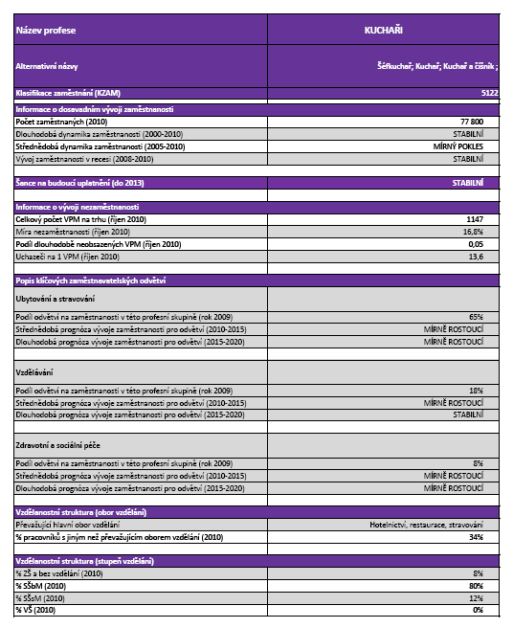
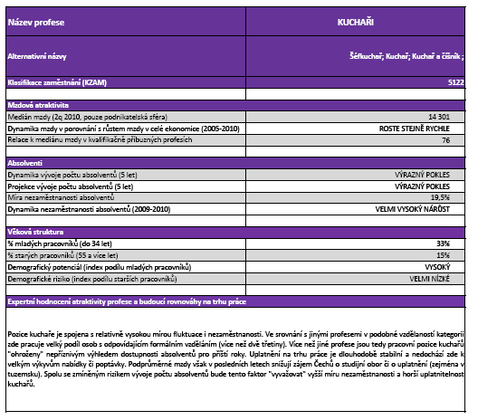
JOB PROFILES
  ...Example of a job profile card...

Slide 33

Czech Future Skills! website
Czech Future Skills! on
www.czechfutureskills.eu
Notes:
33

Slide 34
PRODUCT users
Public policy decision makers
Analyses of skill needs and skill gaps as a base for policies and priorities
(Czech Energy Strategy 2010, Project for support of science and technical fields of study 2009 ...)
Sector studies
Ad-hoc consultancy on labour market issues and strategic documents
Forecast of labour market balance for major occupational and educational clusters (5 year outlook)
Ad hoc analysis of anticipated trends for individual customers (HE institutions, regions, ..)
Public employment service
Forecast of sectoral employment and unemployment rate
Analyses and monitoring of job vacancies
PES training needs analysis and training plan

Slide 35
PRODUCT users
Regional authorities
  Moravia-Silezia region – Regional observatory – part of the Regional employment pact activities
  Zlin region
Education and training providers
Database of occupations aimed at labour market prospects, attractiveness for graduates and employability (job profile cards)
LMI product for training providers
Employability of university graduates in the study fields of the Institute of Chemical Technology, Masaryk university
Carrier counsellors
  Job profile cards
  LMI products for career counsellors

Slide 36
PRODUCT USERS
Professional associations
Sector analyses
LMI product for sector councils
Forecasts of graduates, profiles of educational fields
Consulting
Expertise and knowledge sharing
  Expertise project for Lithuania – Public Policy and Management Institute,
  Partnership support for Polish Labour Market and Education Observatory of Malopolska
General public
czechfutureskills.eu website
DVmonitor.cz website
Publications
Conferences and seminars

Slide 37
Lessons learned
Availability of data influence the choice of approaches
Expertise at different administative levels is needed for in-house and outsourced production of anticipation activities and products
Research activity is not enough to improve decision making
Suitable delivery models need to be developed to keep LMI up-to-date and to reach end users
Systematic cooperation of stakeholders is needed
Sponsors have primary responsibility for the implemenation of results (which may require further investment)
Knowledge base building within providers and users should be promoted

Slide 38
Future of anticipation
Growing demand from stakeholders
Enhancing awareness among users
Skills anticipation system development is an ex-ante conditionality by the EU Commission for EU funds implementation
Priority for 2014-2020

Slide 39
ANTICIPATION SYSTEM
Current situation
- There is no comprehensive anticipation system in the Czech Republic. Segmented projects - initiatives of individual institutions and research. Uncertainty for anticipation activities and cooperation.
Why the anticipation should be systematic?
Quality assurance, credibility of anticipation results – reliability of background information, evaluation of results, using outputs
Know how development needs continuous research activities
Dissemination and use of results require systemic long-term cooperation between institutions

Slide 40
ANTICIPATION SYSTEM REQUIREMENTS
  Key characteristics of the anticipation system
Regularity – anticipation products in regular periods, regular up-dating of results and information products
Methodological continuity – comparability of results, using stable methodological tools for producing products + methodological enhancement
Reliability of results– using different methods for anticipation (quantitative and qualitative) and their combination
Linkages between national, sectoral, regional and European levels
Cooperation and partnership – all institutions providing relevant data; additional information and ad hoc analysis
- users (regular feedback, cooperation in information and experience sharing)

Slide 41
ANTICIPATION SYSTEM
Specific analysis providers
(different institutions: analysis, projections, ad hoc studies, etc.)
Data providers
CZO
MoLSA
Trexima
MoEYS
Eurostat
ANTICIPATION RESPONSIBLE BODY
Responsible for:
Regular projections and other anticipation activities
Methodological development
Information products provision
Dissemination of results
Cooperation with stakeholders
Background analysis
Data
Information products
Users
Decision makers, Carrier counsellors, Sectoral bodies, NQS conceptors, Regional authorities, Educators, General public
Expert groups
Validation of methods, results, effectiveness of dissemination channels , etc.

Slide 42
THANK YOU FOR YOUR ATTENTION!
Ing. Věra Czesaná, CSc.
czesana@nvf.cz
National Training Fund
National Observatory for Employment and Training
www.nvf.cz/observatory
www.czechfutureskills.eu
www.dvmonitor.cz
www.refernet.cz

